Slide 1
Machine Learning
Basic Definition:
Use of statistical methods and their associated algorithms to make inferences on data.

Slide 2
3 Main ML Disciplines
Supervised Learning
  What previously-seen data is my new data most like?
  Classification, Regression
Unsupervised Learning
  What is most similar among my data set?
  Clustering, customer segmentation, image compression
Reinforcement Learning
  What sequence of actions should I take based upon my data to get the best outcome?
  Game playing, optimal policy generation

Slide 3
Supervised Learning
Classification
  Given a known training dataset, what is my new data most similar to?
We have 100,000 patient records that give the ages, genders, income, state of residence, and smoker/non-smoker status, and whether or not they had the flu this year.
If we get a new patient’s age, gender, income, state of residence and smoker/non-smoker status, is it most likely that they had or will get the flu this year?

Slide 4
Features & Classes
Features – the data categories you are using to train the model
  Age
  Genders
  Income
  State of residence
  Smoker/non-smoker status
Class – the question you are asking the model
  “Flu” or “No Flu” (binary “yes/no” classification)
  Multiple classifications are also possible

Slide 5
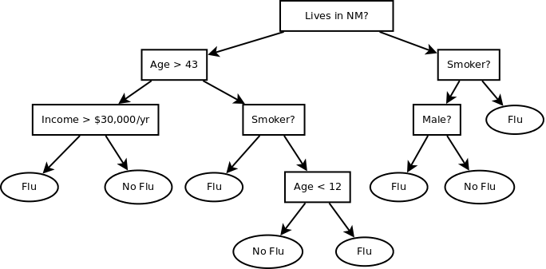
Decision Tree

Slide 6
How Decisions Trees are Built
GenerateTree()
  While a data sample is not properly classified:
  Find the feature which best splits the data
  Split the data using that feature
  For each resulting branch:
    GenerateTree(records in branch)
The algorithm (CART, ID3, C4.5, etc.) decides the definition of “best split”

Slide 7
Decision Trees in Python/Scikit-Learn
Walkthrough decision_tree.ipynb

Slide 8
Overfitting
A perfect fit against your training data only means that you can fit your training set well!
  This is analagous to overfitting in linear regression if you don’t constraint the degrees of freedom (ie. the order of a polynomial equation: y = anx^{n} + … + a2x² + a1x + a0)
Take a random sample (25% or so) as an independent validation dataset, and remove this from your training data.
Tweak your training to optimize your results against the validation dataset.
Use pruning.

Slide 9
Data Sets
4 Data Sets
  Training Data – Data used to train your model
  Cross-Validation Data – A random sample of your training data, used to optimize iterative algorithms (Neural Networks, SVM, etc.)
  Validation Data – A representative (test) data set that you set aside at the beginning of your experiment to validate your model. THIS DATA IS NEVER USED FOR TRAINING!
  Test Data – Unclassified data that is classified by your trained ML algorithm.

Slide 10
Pruning
Adds noise into the trained model.
Generalizes the model so that anomalies don’t overly effect the model.
Decision Trees
  Nodes with a low number of samples can be deleted, and get misclassified at the parent node. In practice, the classification percentage usually increases.
  Decreases the complexity of the tree, making it faster to execute.

Slide 11
Neural Networks
Another supervised learning technique - classification
Similar to but entirely unlike Decision Trees
Inspired by animal neurons and their activation thresholds

Slide 12
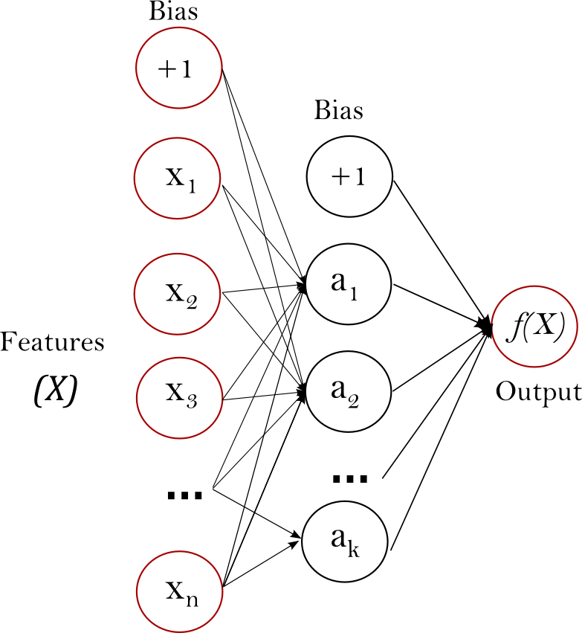
Neural Networks

Slide 13
Neural Network Theory
Often 2 or more “layers” of perceptrons.
  1 Output layer
  1 or more “hidden” layers
Each perceptron has one or more inputs and one output.
The output of a perceptron can an input a perceptron at the next layer.
A perceptron is “activated” when the sum of input values equals or exceeds a threshold (often 0.5).
  The activation is defined by the logistic function or another activation function

Slide 14
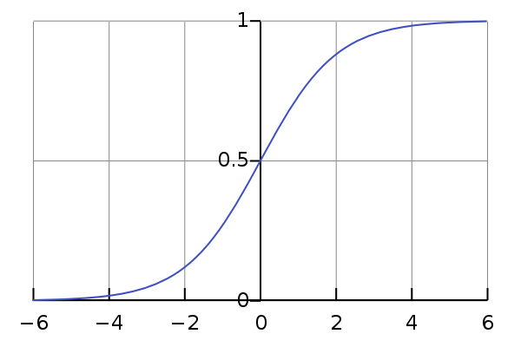
Logistic Function
For each perceptron: y = sum(c[i] * x[i] for i in perceptron_inputs)
perceptron output = 1 if y >= 0.5 else 0

Slide 15
Training
Training NN optimizes the coefficients (weights) of each input to each perceptron
Backpropagation
  For each misclassification during training
    Walk the neural network backwards, adjust all weights, changing those that were most responsible for the misclassification the most
Continue to iterate through the dataset until the classification percentage is acceptable and the model has converged
Overfitting is possible with NN as well

Slide 16
Example
Is it possible to get a Neural Network to decode binary data to ascii?
Consider that neural networks work purely by summing weighted perceptron outputs together to exceed some threshold.
See nn_binary.ipynt

Slide 17
NN in scikit-learn

